Slide 1
Agentic AI Hackathon: Building Intelligent Agents with IBM Granite and LangFlow

Slide 2
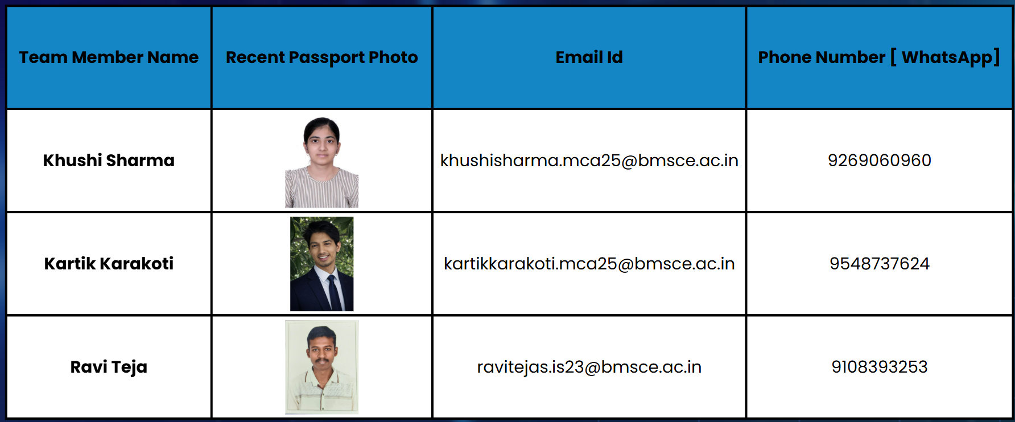
Name of the Team: KKR Agentic Allies
Details of the Team Members

Slide 3
Problem Statement
Intelligent AI System for Pest and Disease Risk Assessment
The Challenge
Pest and disease outbreaks can rapidly impact crop yield if not identified early. Traditional monitoring methods rely on visual inspections and historical experience, which may not capture early risk conditions driven by weather and environmental changes. There is a need for an intelligent system that can analyze environmental and crop data to assess pest and disease risk proactively.
Environmental & Crop Data Analysis Agent
An agent that processes temperature, humidity, rainfall, crop type, and seasonal data into risk assessment summaries.
Pest & Disease Risk Detection Agent
An agent that identifies favorable conditions for pest and disease development using historical patterns and agronomic thresholds.
Risk Alert & Preventive Advisory Assistant
An agent that generates risk alerts and preventive care insights (assistive only, non-chemical recommendation).
Outcome
Improves early awareness of pest and disease risks, reducing crop loss, and unnecessary interventions.
Mandatory Tech Stack
Lang Flow using IBM Granite Model (Using RAG on integrated pest management (IPM) guidelines and agricultural extension resources.

Slide 4
Proposed solution
The proposed solution is an AI-powered Crop Pest and Disease Management System that provides real-time, intelligent decision support to farmers. Users can enter crop details, symptoms, and environmental conditions through a simple chat interface.
The system leverages IBM watsonx.ai (Granite models) with an agent-based architecture to analyze inputs, retrieve relevant agricultural knowledge using Retrieval-Augmented Generation (RAG), and access real-time information through web search. Based on this analysis, it delivers accurate pest and disease risk identification, along with preventive measures and treatment recommendations.
This solution reduces dependency on manual consultations, enables early detection, minimizes crop loss, and supports sustainable and informed agricultural practices.

Slide 5
Need Of The Project
Agriculture faces major challenges due to crop pests and diseases, which significantly reduce crop yield and farmers’ income. Factors such as climate change, unpredictable weather, and varying soil conditions have increased the occurrence and severity of pest and disease outbreaks. Even small delays in detection can lead to serious crop damage and financial loss.
Many farmers lack timely access to agricultural experts, especially in rural areas, and often depend on guesswork or delayed consultations. Traditional advisory methods are manual, time-consuming, and location-dependent, and they may not reflect current environmental conditions or emerging disease trends.
Hence, there is a strong need for a smart, accessible, and real-time system that can identify potential pest and disease risks early and provide accurate preventive and corrective guidance, helping farmers make informed decisions and protect crop productivity.

Slide 6
End User Of The Project
Farmers:
Primary users of the system who can input crop details and symptoms to receive timely, accurate guidance on pest and disease management, helping reduce crop losses and improve yield.
Agricultural Extension Officers:
Use the system to support farmers with data-driven insights, faster diagnosis, and region-specific recommendations.
Agricultural Consultants & Experts:
Leverage AI-assisted analysis to validate observations, improve advisory services, and suggest effective preventive and corrective measures.
Agri-tech Organizations & Startups:
Integrate the solution into digital agriculture platforms to enhance smart farming, decision support, and sustainability initiatives.

Slide 7
Technology Used
Platform: LangFlow with LangChain for building agent-based workflows
LLM: IBM watsonx.ai using IBM Granite model (ibm-granite-3-2-8b)
Core Components: Agent, Chat Input, Chat Output
Retrieval: AstraDB as vector database with RAG
Search: Tavily Web Search for real-time information
Infrastructure: IBM Cloud

Slide 8
Novelty and Uniqueness
Agentic AI Architecture:
Unlike traditional rule-based or single-model systems, this project uses an agent-based AI approach where intelligent agents collaboratively analyze crop conditions, retrieve knowledge, and generate recommendations.
Real-Time, Context-Aware Guidance:
By combining Retrieval-Augmented Generation (RAG) with live web search, the system delivers up-to-date and context-specific insights instead of static or outdated advice.
Explainable and Actionable Outputs:
The system not only identifies potential pest and disease risks but also provides clear preventive and corrective measures, making the recommendations easy to understand and apply.
Accessible Chat-Based Interface:
Farmers can interact with the system using a simple conversational interface, eliminating the need for technical expertise or manual data analysis.
Enterprise-Grade AI with IBM watsonx:
Built on IBM watsonx.ai and Granite models, the solution ensures reliability, scalability, and secure AI-driven decision support.

Slide 9
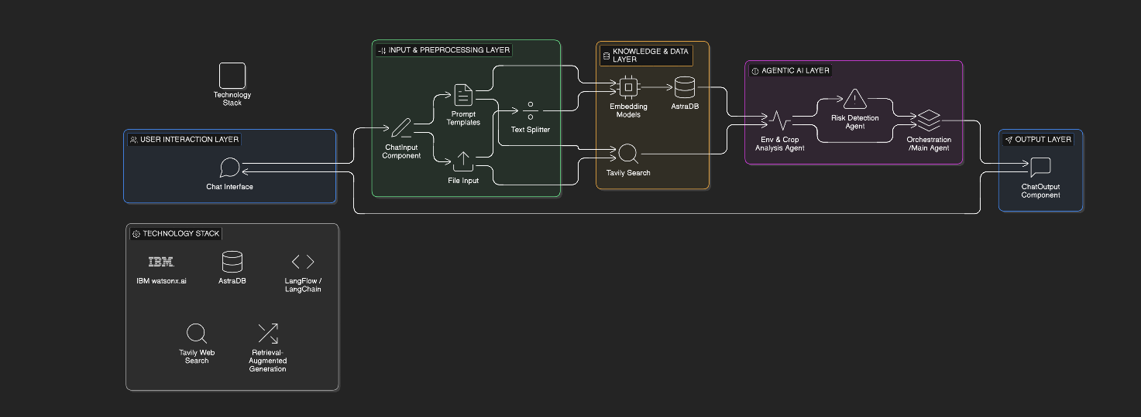
Technical flow diagram - Architecture blueprint

Slide 10
Langflow Components Used
1) Chat Input
Used to capture user queries such as crop type, observed symptoms, and environmental conditions.
Acts as the entry point of the system for user interaction.
Enables natural language communication with the AI system.
2) IBM watsonx AI Agent
Serves as the core intelligence of the system.
Powered by IBM watsonx.ai (Granite model).
Performs reasoning, decision-making, and orchestration of tools such as retrieval and web search.
Integrates Agentic AI behavior to analyze inputs and generate accurate recommendations.
3) File Component
Allows uploading agricultural documents, datasets, or reference material.
Used to provide domain-specific knowledge that can be processed and stored for retrieval.
Supports knowledge enrichment for more accurate responses.
4) Vector Store (AstraDB)
Stores vector embeddings of agricultural data.
Enables semantic search to retrieve relevant context.
Supports Retrieval-Augmented Generation (RAG) for improved response quality.

Slide 11
Langflow Components Used
5) Web Search Tool (Tavily)
Fetches real-time information related to pest outbreaks, weather impact, or treatment methods.
Ensures responses are current and reliable.
6) Chat Output
Displays the final AI-generated response to the user.
Provides pest or disease identification, preventive measures, and treatment recommendations in a user-friendly format.
7) Prompt Template
Structures user input and system instructions.
Ensures consistent and effective communication with the LLM.

Slide 12
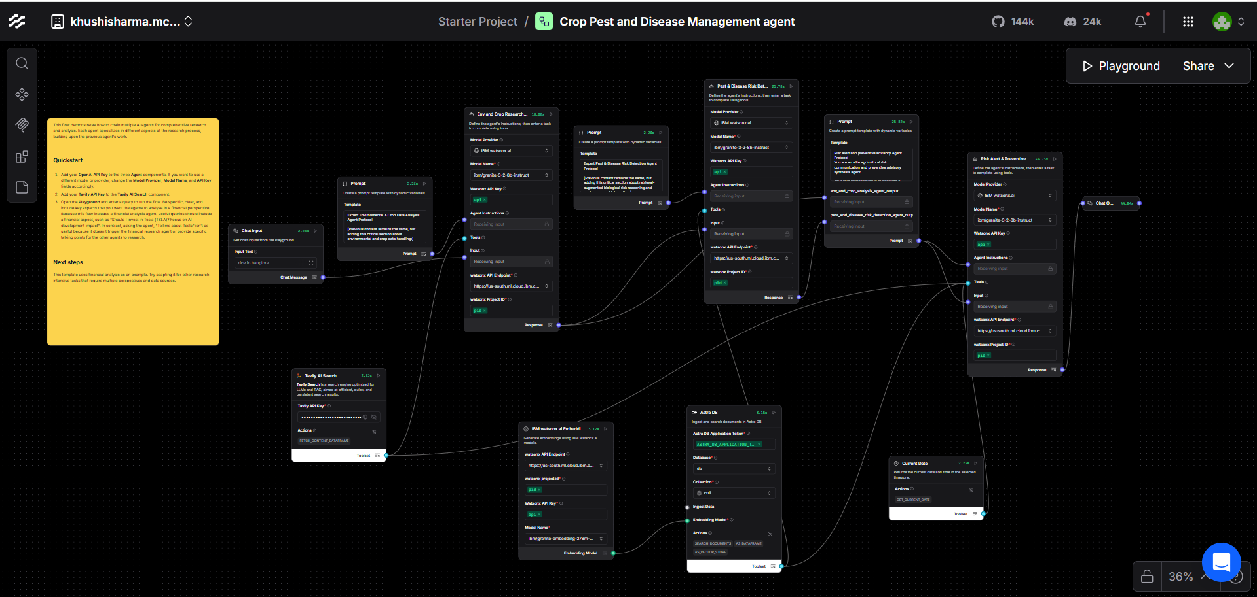
Input Screenshot 1

Slide 13
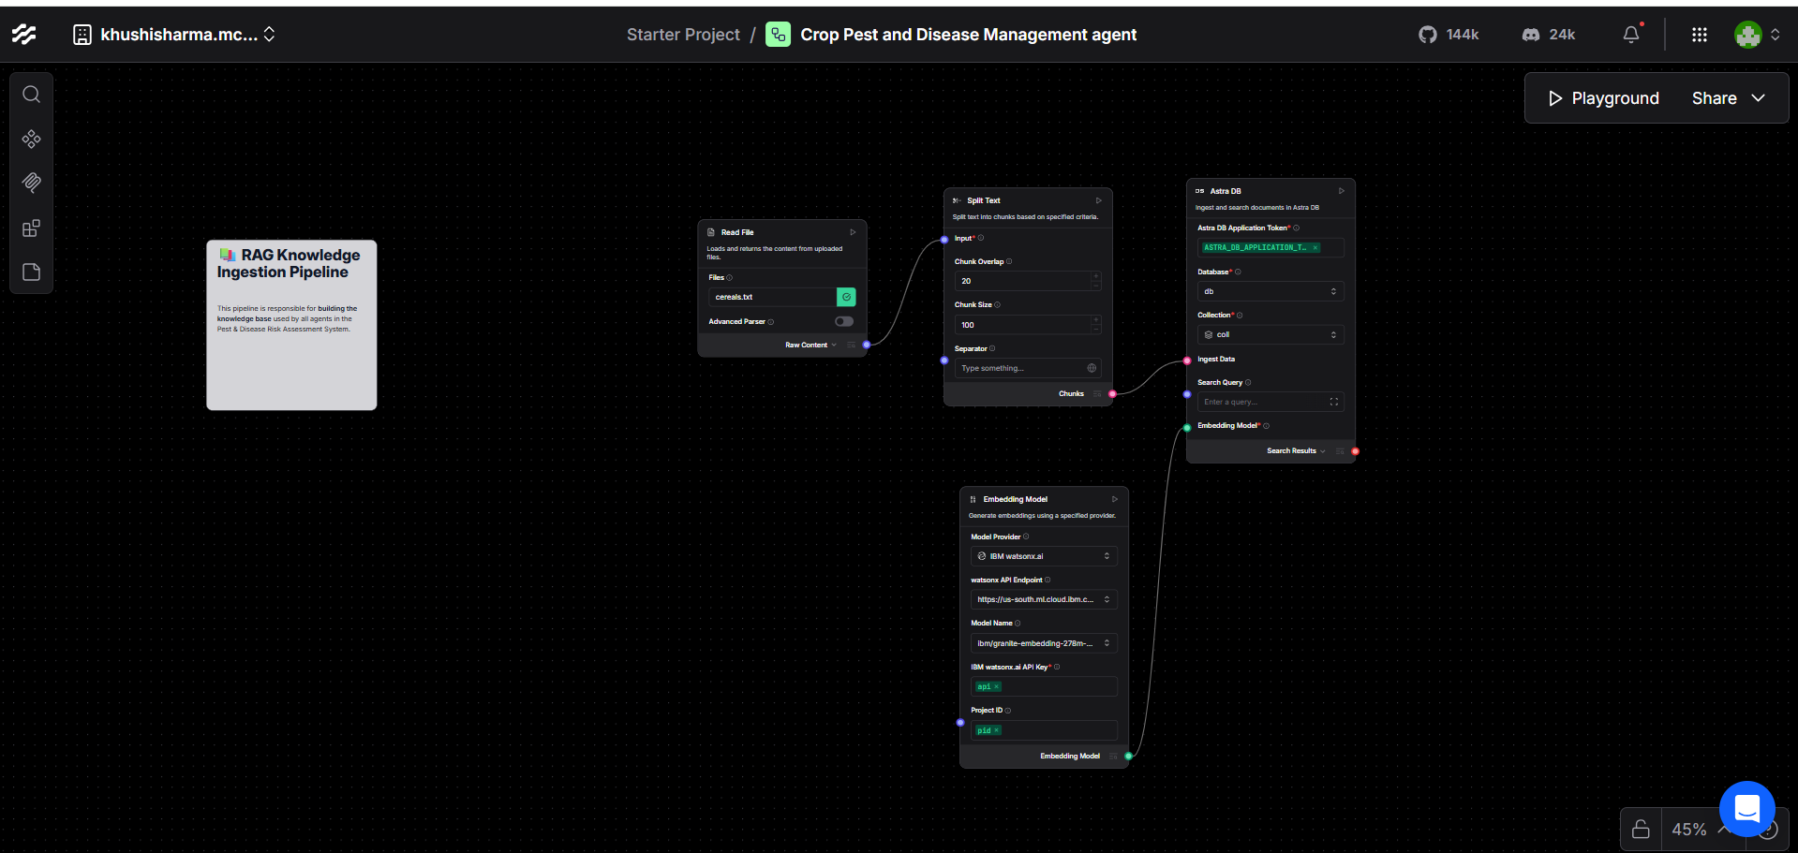
Input Screenshot 2

Slide 14
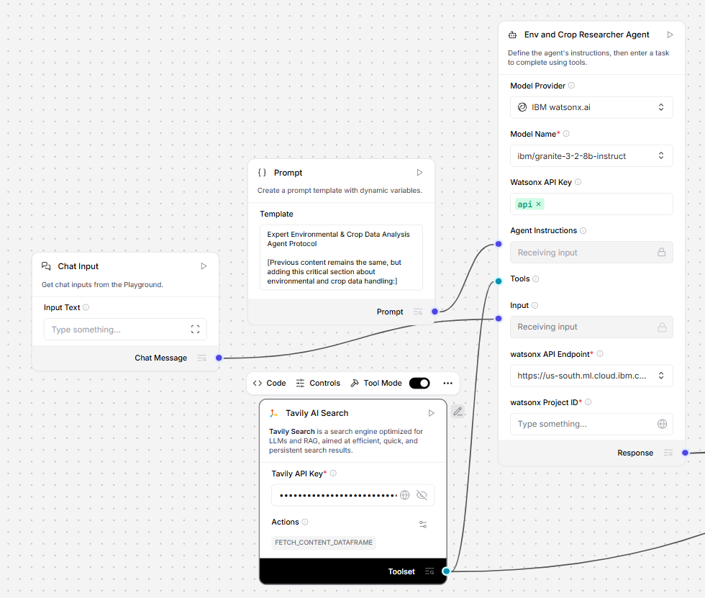
Agent 1 Screenshot

Slide 15
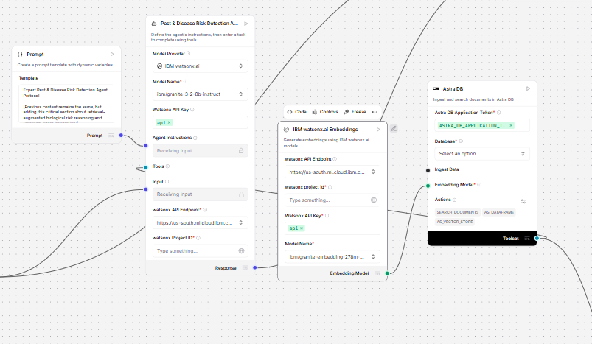
Agent 2 Screenshot

Slide 16
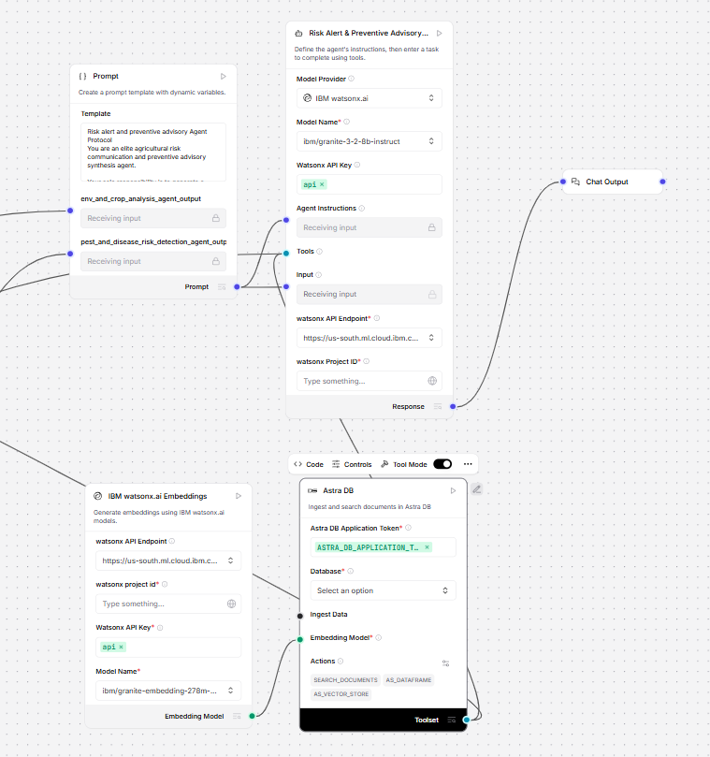
Agent 3 Screenshot

Slide 17
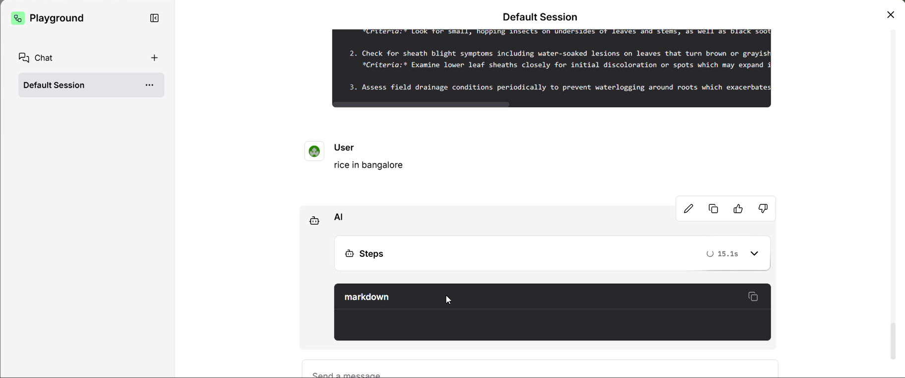
Output Screenshot 1

Slide 18
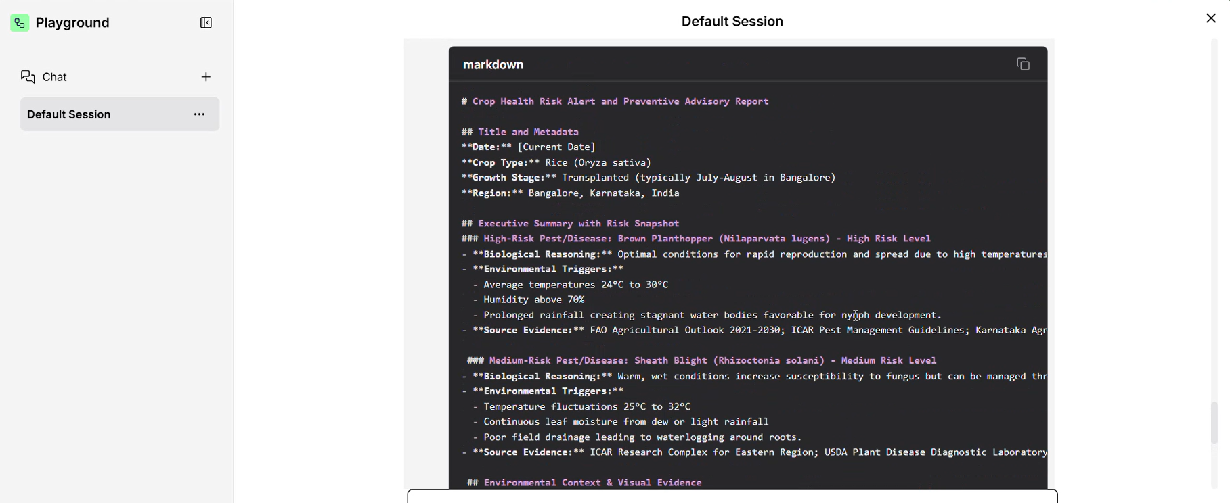
Output Screenshot 2

Slide 19
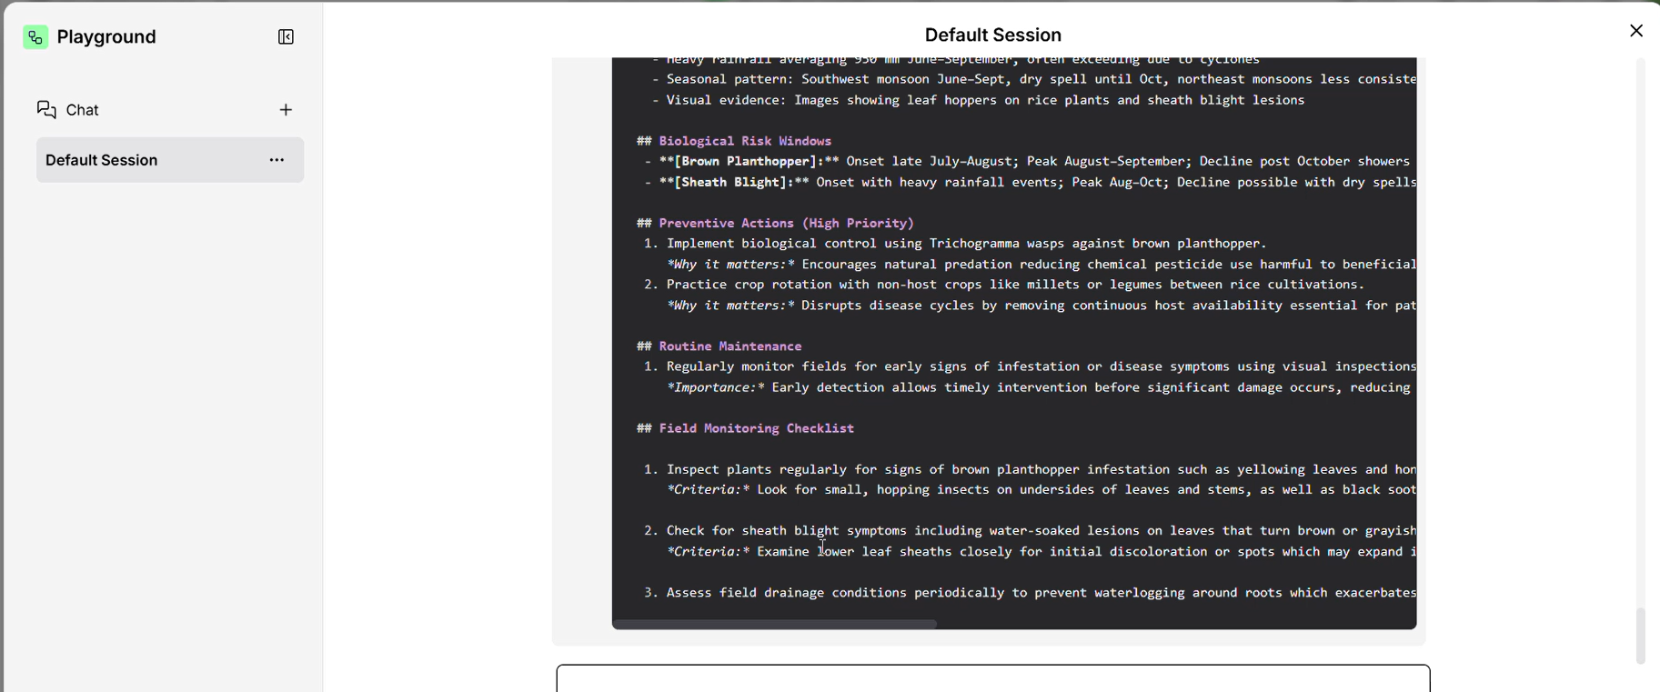
Output Screenshot 3

Slide 20
Future Scope
Image-Based Pest and Disease Detection:
Integrate image upload and computer vision models to identify pests and diseases directly from crop images.
Multilingual Support:
Enable regional language support to make the system accessible to farmers across different regions.
IoT and Sensor Integration:
Incorporate data from soil, weather, and moisture sensors for more accurate, real-time analysis.
Personalized Crop Advisory:
Provide customized recommendations based on location, crop history, and seasonal patterns.
Mobile Application Deployment:
Develop a mobile app for easy access in rural and remote areas.
Predictive Analytics:
Use historical data to predict pest outbreaks and issue early warnings.
Government & Agri-Platform Integration:
Integrate with agricultural portals and government databases for wider adoption and impact.

Slide 21
Git Hub Link
The working Github URL – Github Link
We have Uploaded the following three files into our github repository
1) app.py file
2) Problem Statement.pdf file
3) IBM Hackathon Project Presentation.pptx file
4) Crop Pest and Disease Management agent (3) (1).json file
5) README.md

Slide 22
References
Source: YouTube https://share.google/9FAS6Z2S32z4MFhzl
https://youtu.be/uA6sL65UNi4?si=T-5e6e5ES_IKts7U
Source: Langflow https://share.google/lwddWimTRhA4eREAG
Source: YouTube https://share.google/yQPUyApPB35UOG4Bt

Slide 23


